Slide 1
Workshop-6 Mechanical Integrity (MI)
Group-3
FARUK MOHAMMAD AZAD
BADRIA AL HATALI
MOHAMMAD ABUSUFYAN
ALIA ALJAIDI
RAINEAR A. MENDEZ
JAE HEE PARK

Slide 5
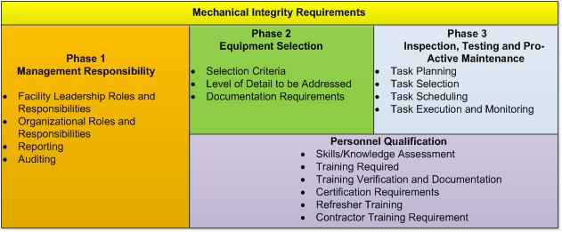
Frame of Mechanical Integrity

Slide 6
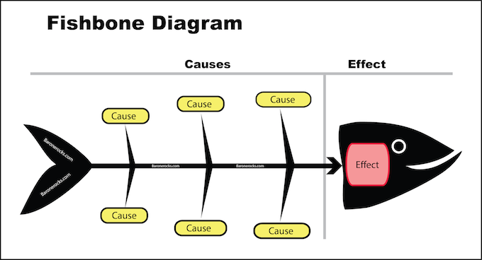
Risk Assessment
Machine factors
Interlock malfunction at cold temperature
Vaporizer did not restart because of that
Human factors
The operator was absent at the interlock test.
Personal Qualifications: operator was not trained well
Human Factors
Measurements
Materials:
4K of gallons Dowtherm (is a heat transfer fluid) decomposes at a low temperature
Materials
Methods:
Standard operating procedure
Implementation guidelines defect
Environmental:
Are not applicable in this scenario
Machine Factors
Overheated ruptured tube
Methods
Environmental

Slide 7
Recommendations
Human factors:
Stress on operationally policy and guidelines
SOP for testing should include different situations / scenarios based which include lower-mid-high temperatures
Operators availability during interlock low level testing

Slide 8
Recommendations
Machine factors:
Interlock should works at various temperatures
Alarm system should work on low level
Defects are resolved before continuing operation

Slide 9
THANK YOU!

